Slide 1
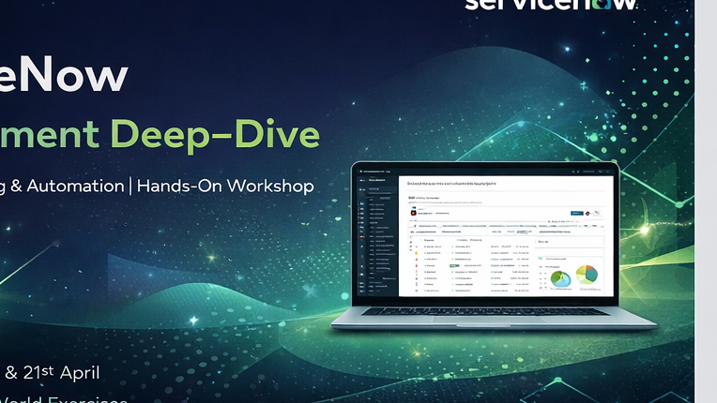
ServiceNow
Development Deep–Dive
Enterprise Scripting & Automation | Scenario-First Hands-On Workshop
19 APRIL
21 APRIL
REAL USE CASE
From form behavior to business rules, reusable script includes, events, scheduled jobs, and production-style notification design.
Notes:
[Sources] - premiujm.pdf, pages 1-2: title, dates, topic outline, learning outcome. - title_bg.png derived from user-approved generated design asset in this conversation.

Slide 2
How these sessions are redesigned
FEEDBACK-DRIVEN
WHY BEFORE HOW
EXAMPLE AFTER TOPIC
PROJECT LADDER
1. Concept first
2. Confirmation examples
3. Progressive practice
Start with the business scenario, actor journey, and why the tool exists before any configuration.
Each major concept ends with a short example, a mini script, and a visible expected result.
The workshop builds one incident escalation solution step by step instead of repeating disconnected tasks.
Target feedback shift
• Students see the full picture before the click path.
• Every script is tied to a realistic enterprise incident case.
• Homework becomes structured, cumulative, and easier to retain.
Notes:
[Sources] - Feedback files Pasted text.txt and Pasted text (2).txt: students requested conceptual-first explanation, real-life examples, clearer pacing, and progressive practice.

Slide 3
Two-day roadmap and final deliverable
OUTLINE
DAY 1 · 19 APRIL
DAY 2 · 21 APRIL
Core scripting
Advanced development
• Client-side scripting: onLoad, onChange, onSubmit, g_form API
• UI behavior and validation logic; UI Policies vs Client Scripts
• Server-side CRUD with GlideRecord and GlideRecordSecure
• GlideDateTime, gs.info(), gs.log(), and business-rule timing
• Extra tools: Background Scripts, UI Actions, Reference Qualifiers
• Reusable architecture with Script Includes and modular logic
• Scheduled Jobs, custom events, and event-driven automation
• Notification triggers, Email Scripts, and template customization
• End-to-end incident escalation orchestration with testing mindset
Final build
Deliverable by end of Day 1
A production-style incident escalation flow that combines client logic, server logic, business rules, events, notifications, and scheduled monitoring.
A working incident form that validates P1 logic, filters assignee choices, and runs clean server-side checks.
Notes:
[Sources] - premiujm.pdf, pages 1-2: full day-by-day workshop outline, prerequisite knowledge, and real-world scenario definition.

Slide 4
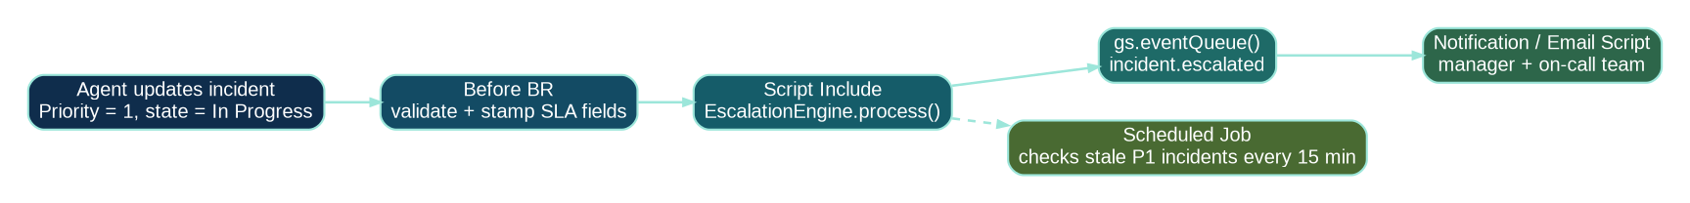
Anchor scenario: Incident Escalation System
BUSINESS CASE
What problem are we solving?
• P1 incidents must never wait silently without ownership.
• Agents need clear form guidance when the priority is critical.
• Managers need instant escalation signals and reminder emails if updates stall.
• Assignment choices should be filtered to the right support teams.
• The platform must stay secure, reusable, and easy to debug.
End-to-end flow we will build across both days
Success measures
Client guidance
Server validation
Automation
Reusable logic
Fewer missed P1 handoffs, faster ownership, cleaner audit trail, and reusable escalation logic.
Make the form smarter before save.
Keep critical rules enforceable and secure.
Queue events, emails, and time-based reminders.
Move repeatable logic into Script Includes.
Notes:
[Sources] - premiujm.pdf, page 2: official real-world scenario is an Incident Escalation System combining Business Rules, Script Includes, Events, Notifications, and Scheduled Jobs.

Slide 5
Big picture: where each scripting tool fits
ARCHITECTURE
Client layer
Server layer
Business rule engine
Automation layer
Best for immediate guidance, visibility, mandatory logic, and input feedback.
Best for secure CRUD, date logic, reusable APIs, and reliable enforcement.
Best for record lifecycle timing before, after, query, display, and async.
Best for events, emails, and scheduled checks after the record work is done.
Teaching rule for these sessions: always explain the business reason first, then show which layer owns that problem.
Notes:
[Sources] - servicenow-xanadu-application-development-enus.pdf, pages 1362-1363: client-side scripts, server-side scripts, and script types by runtime. - premiujm.pdf, pages 1-2: day-1/day-2 scope and incident scenario.

Slide 6
Client-side scripting fundamentals
DAY 1
When each client script runs
ONCHANGE EXAMPLE
1 function onChange(control, oldValue, newValue, isLoading) { 2 if (isLoading || newValue == oldValue) return; 3 4 if (newValue == '1') { 5 g_form.setMandatory('assignment_group', true); 6 g_form.showFieldMsg( 7 'assignment_group', 8 'P1 incidents need an owning team', 9 'info' 10 ); 11 } else { 12 g_form.hideFieldMsg('assignment_group', true); 13 } 14 }
onLoad
When the form opens
Set defaults, show messages, hide or reveal fields.
onChange
When a watched field changes
React to priority, category, caller, impact, etc.
onSubmit
Right before save
Last client-side validation before the request is sent.
What students should notice during the demo
• The form reacts instantly before a save happens.
• The rule is visible and explainable to a business stakeholder.
• The script stays small because it owns only user experience logic.
Docs note: onChange also fires when the page loads, so the isLoading guard matters.
Notes:
[Sources] - servicenow-xanadu-application-development-enus.pdf, pages 1362-1363: onLoad, onChange, and onSubmit definitions. - Feedback files: students asked for conceptual explanation and confirmation examples after each topic.

Slide 7
g_form toolkit and client-side best practices
DAY 1
getValue()
setValue()
G_FORM EXAMPLE
Read the current form value before making a decision.
Default or update dependent fields with a visible reason.
1 function onLoad() { 2 if (g_form.getValue('priority') == '1') { 3 g_form.setDisplay('u_major_incident_bridge', true); 4 g_form.setMandatory('assignment_group', true); 5 } 6 }
setMandatory()
setDisplay()
Guide the user when certain conditions must be completed.
Reduce clutter by showing only what matters for this scenario.
Official best-practice guidance to repeat live during teaching
• Use UI Policies and Data Policies before writing client script whenever configuration is enough.
• Keep the isLoading guard in onChange scripts and check newValue against oldValue.
• Prefer asynchronous GlideAjax over client-side GlideRecord or many getReference() calls.
• Avoid global client scripts and DOM manipulation against core UI elements.
Notes:
[Sources] - servicenow-xanadu-application-development-enus.pdf, page 1772: UI Policies/Data Policies before scripting, isLoading and newValue checks, async GlideAjax preference, avoid global client scripts and DOM manipulation.

Slide 8
UI Policies vs Client Scripts: choose the right lever
DECISION GUIDE
UI Policy
Client Script
Data Policy / BR
• Show / hide fields
• Read only / mandatory hints
• Best when the logic is mostly declarative
• Great for user experience and maintainability
• Cross-field validation or nuanced behavior
• Message timing and conditional value logic
• Needed when configuration alone is not enough
• Keep it small and focused on form behavior
• Server-side enforcement
• Mandatory checks that must hold everywhere
• Use when the rule cannot depend on one UI only
• Protects imports, APIs, and background updates too
Think: “Can configuration solve this without code?”
Think: “Does the form need custom behavior while the user is typing?”
Think: “If someone updates the record outside the form, must this still be enforced?”
Notes:
[Sources] - servicenow-xanadu-application-development-enus.pdf, page 1772: UI Policies are useful for suggestion; Data Policies and Business Rules for enforcement like making a field mandatory.

Slide 9
Server-side scripting essentials
DAY 1
What belongs on the server?
SERVER EXAMPLE
1 var cutoff = new GlideDateTime(); 2 cutoff.addMinutesUTC(-15); 3 4 var inc = new GlideRecordSecure('incident'); 5 inc.addActiveQuery(); 6 inc.addQuery('priority', 1); 7 inc.addQuery('sys_updated_on', '<', cutoff); 8 inc.query(); 9 10 while (inc.next()) { 11 gs.info(inc.number + ' needs escalation review'); 12 }
• Secure record CRUD and related-record updates
• Reusable logic shared by Business Rules, UI Actions, and Scheduled Jobs
• Date/time calculations, audit-friendly logs, and event firing
• Anything that must work beyond one specific browser form
Scope mindset
Scoped apps use scoped APIs. Global scope bypasses many protections, so new work should stay scoped when possible.
Why this matters in the story
• GlideRecordSecure respects ACL behavior while reading/updating records.
• GlideDateTime keeps time-based escalation logic explicit and reviewable.
• gs.info() gives a simple first debugging trail before heavier test tooling.
Notes:
[Sources] - servicenow-xanadu-application-development-enus.pdf, pages 1362-1363: server-side scripting scope and runtime. - servicenow-xanadu-application-development-enus.pdf, pages 1408-1409: GlideRecordSecure examples, GlideSystem logging, GlideDateTime guidance.

Slide 10
Business Rules that stay fast, clear, and predictable
DAY 1
Before
After
Async
Set values and block bad saves before the database commit.
React once the record is saved and related work can safely start.
Move slower work off the user transaction.
Validate P1 ownership, stamp urgency, abort if essential data is missing.
Cascade child updates or queue a custom escalation event.
Heavy recalculation, bulk follow-up, or delayed notification logic.
Official best practices to reinforce verbally
• Keep Business Rules small and specific.
• Always use conditions whenever possible.
• Store reusable logic in Script Includes instead of growing a giant rule.
• Use queries to limit the records processed.
Notes:
[Sources] - servicenow-xanadu-application-development-enus.pdf, page 1772 and following: Business Rule best practices and before/after/async guidance.

Slide 11
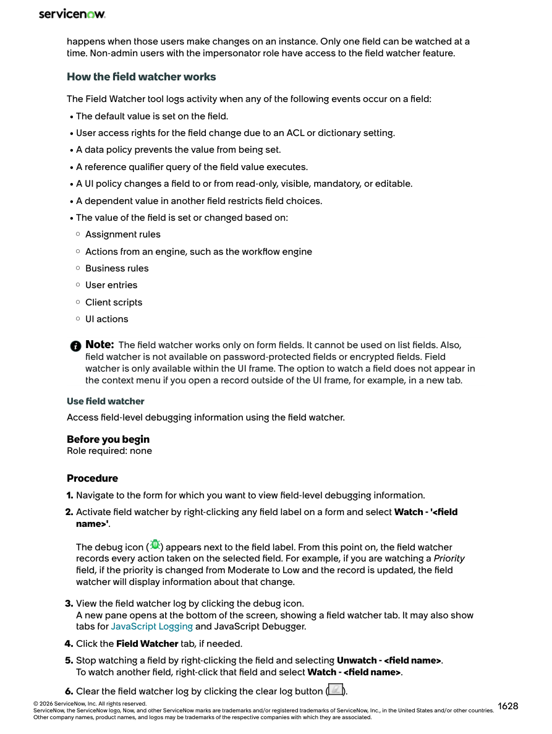
Extra developer tools that solve real form problems
DAY 1
Background Scripts
UI Actions
Reference Qualifiers
Field Watcher
Fast admin-only scratchpad to test a query, patch a record, or inspect data safely in a controlled way.
Button or link logic for explicit user actions such as “Escalate now”, “Create bridge”, or “Close as duplicate”.
Dynamically restrict reference options so the user sees only the teams or records that make sense.
Visual debugging aid that shows what changed a field and why.
Reference qualifier and debugging talking points
• Reference qualifiers can use simple conditions or advanced logic such as JavaScript or existing Script Includes.
• Field Watcher exposes UI Policy, Client Script, Business Rule, reference qualifier, and dependent-field effects on a field.
• This is the right slide to slow down and explain cause-and-effect visually.
Notes:
[Sources] - premiujm.pdf, page 1: Background Scripts, UI Actions, Reference Qualifiers included in day 1 outline. - servicenow-xanadu-application-development-enus.pdf, page 1874: reference qualifier types and advanced options. - servicenow-xanadu-application-development-enus.pdf, page 1628: Field Watcher behavior and procedure.

Slide 12
Day 1 guided build: one scenario, five checkpoints
HANDS-ON
Checkpoint 1
Checkpoint 2
Checkpoint 3
Checkpoint 4
Checkpoint 5
Client script
UI behavior
Server validation
Data query
Debug proof
When Priority = 1, require Assignment Group and explain why.
Show or hide major-incident fields using g_form or UI Policy.
Add a Before Business Rule so APIs and imports obey the same rule.
Use GlideRecordSecure to inspect active P1 incidents safely.
Use logs and Field Watcher to prove what changed the form.
The learner leaves Day 1 with a complete mental model: what the user sees, what the server enforces, and how to debug both.
Notes:
[Sources] - premiujm.pdf, page 1: Day 1 outline topics. - Feedback files: students asked for confirmation examples, structured pacing, and understanding the why before implementation.

Slide 13
Reusable architecture with Script Includes
DAY 2
Why move logic out of Business Rules?
SCRIPT INCLUDE
1 var EscalationEngine = Class.create(); 2 EscalationEngine.prototype = { 3 process: function(incidentSysId) { 4 var inc = new GlideRecordSecure('incident'); 5 if (!inc.get(incidentSysId)) return; 6 7 if (inc.priority == 1) { 8 gs.eventQueue('incident.escalated', inc, 9 inc.assigned_to, inc.assignment_group); 10 } 11 }, 12 type: 'EscalationEngine' 13 };
• Business Rules stay small and easy to reason about.
• The same logic can be reused by UI Actions, Scheduled Jobs, and other server scripts.
• Client-callable Script Includes can expose tightly controlled AJAX helpers when needed.
• Security stays explicit: client-callable access requires ACL-aware design.
Future note
Optional GlideAjax extension
Official docs recommend JavaScript modules for new scripts when possible, but Script Includes remain central to this workshop architecture.
If a client script needs server data, a carefully designed client-callable Script Include can return only what the browser needs — no more.
Notes:
[Sources] - premiujm.pdf, page 2: Script Includes and modular scripting approach. - servicenow-xanadu-application-development-enus.pdf, pages 1242-1243: Script Include API, clientCallable property, and recommendation to use JavaScript modules for new scripts when possible. - servicenow-xanadu-application-development-enus.pdf, pages 1429-1430: Glide AJAX enabled Script Includes and security/privacy considerations.

Slide 14
Automation patterns: Scheduled Jobs and event-driven design
DAY 2
SCHEDULED JOB
Design rule to say out loud
1 var stale = new GlideRecordSecure('incident'); 2 stale.addActiveQuery(); 3 stale.addQuery('priority', 1); 4 stale.query(); 5 6 while (stale.next()) { 7 gs.eventQueue('incident.escalation.reminder', stale, 8 stale.assigned_to, stale.assignment_group); 9 }
• Use events when something meaningful happened.
• Use Scheduled Jobs when time passed and you need to check for drift or neglect.
• Keep the notification decision out of the UI so the process stays reliable.
Notes:
[Sources] - premiujm.pdf, page 2: Scheduled Jobs, event-driven architecture, and custom events & triggers. - servicenow-xanadu-application-development-enus.pdf, page 1772 and related scripting guidance: Business Rules, Script Includes, and automation tool positioning.

Slide 15
Notifications and dynamic email content
DAY 2
Notification flow
EMAIL SCRIPT
1 // Email Script snippet 2 template.print('Incident ' + current.number + 3 ' is still Priority 1 after 15 minutes.'); 4 template.print('<br/>Owner: ' + current.assignment_group); 5 template.print('<br/>Latest update: ' + current.short_description);
• Business Rule or Scheduled Job queues an event.
• Notification listens for that event and selects recipients.
• Email Script prints dynamic details into the template.
• Template wording stays business-readable, not developer-only.
Testing mindset
• ATF can validate outbound email by checking the Email [sys_email] table.
• That gives learners a concrete “prove it works” step after the event and notification are configured.
• This closes the loop students asked for: scenario → build → visible result → verification.
Teaching cue
Explain who receives the email, why they receive it, and what action the message is trying to trigger.
Notes:
[Sources] - premiujm.pdf, page 2: event-based notifications, Email Scripts, and template customization. - servicenow-xanadu-application-development-enus.pdf, page 2641: ATF validation of outbound email in sys_email.

Slide 16
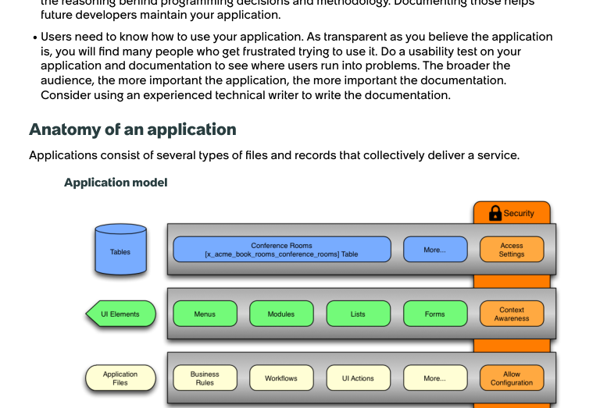
Translate the solution into real ServiceNow application parts
OFFICIAL MODEL
Map our workshop build to the platform model
• Table: incident data and escalation-related fields
• Forms / UI elements: client scripts, UI Policies, and reference qualifiers
• Application files: Business Rules, UI Actions, Script Includes, notifications
• Security: scoped design, ACL-aware querying, careful client-callable exposure
• Testing / maintenance: logs, Field Watcher, ATF, and clean update discipline
Students do not just “add records” — they see how tables, forms, logic, security, and automation fit one application model.
Notes:
[Sources] - servicenow-xanadu-application-development-enus.pdf, page 27 (application model diagram) and pages 27-33 (application files, scope, tables, dependencies).

Slide 17
Progressive practice ladder for higher retention
HOMEWORK
Task 1
Task 2
Task 3
Task 4
P1 validation
Smarter routing
Escalation event
Reminder automation
Require assignment group + explain the reason on the form.
Filter groups with a reference qualifier based on service/category.
Move the eventQueue call into a reusable Script Include.
Create a Scheduled Job and prove the reminder email was generated.
This directly answers the feedback theme that practice should build on previous work instead of repeating the same isolated steps.
Notes:
[Sources] - Feedback files Pasted text.txt and Pasted text (2).txt: students asked for non-redundant, progressive homework with real use cases and business logic.

Slide 18
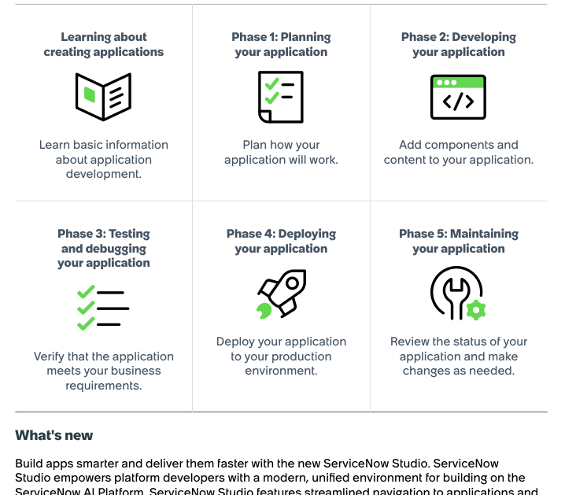
What learners will leave with
OUTCOME
By the end of these two days, participants can…
• Explain why a rule belongs on the client, server, or automation layer.
• Build secure CRUD and validation logic with GlideRecordSecure and Business Rules.
• Design reusable Script Includes instead of duplicating logic.
• Trigger events, notifications, and scheduled reminders for real business outcomes.
• Debug and verify behavior using logs, Field Watcher, and email-oriented ATF checks.
Closing message to reinforce confidence
You are not learning random scripts. You are learning how enterprise ServiceNow solutions are planned, developed, validated, automated, and maintained as one coherent application.
Notes:
[Sources] - premiujm.pdf, page 2: learning outcome. - servicenow-xanadu-application-development-enus.pdf, pages 4-6: app development phases and testing/deployment/maintenance lifecycle.

